Slide 1
Bias and Variance Tradeoff

Slide 2
Bias and Variance
Bias refers to the error caused by oversimplifying a model
while variance refers to the error from making the model too sensitive to training data.

Slide 3
Bias in Decision Trees
Bias means the error caused by overly simple assumptions in the model.
If the model is too simple, it cannot capture the true pattern in the data.
This leads to underfitting.
If Area < 1000 sq ft → Price = 20 lakh Else → Price = 50 lakh(Very simple logic)In reality more number of features will takes place

Slide 4
Bias
So the model is too simple → High Bias → Underfitting
Characteristics of High Bias
Model too simple
Poor performance on training data
Poor performance on test data

Slide 5
Variance in Decision Trees
Variance means the model is too sensitive to training data changes.
Decision Trees can easily memorize the training data if we allow deep trees.

Slide 6
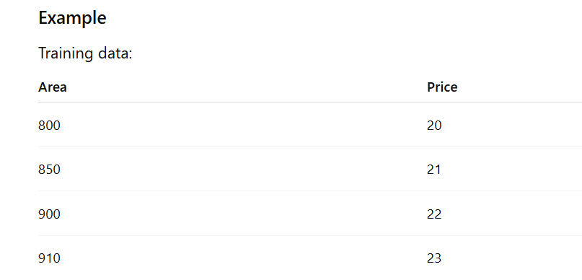
Example

Slide 7
A deep decision
Area < 820
Area < 860
Area < 905
Area < 915 tree may create many splits:
The tree becomes very complex and fits training data perfectly.

Slide 8
Area =
Prediction may be wrong.
So this is High Variance → Overfitting.
880

Slide 9
Characteristics of High Variance
Model very complex
Training accuracy high
Test accuracy low
Small data change → large model change

Slide 10
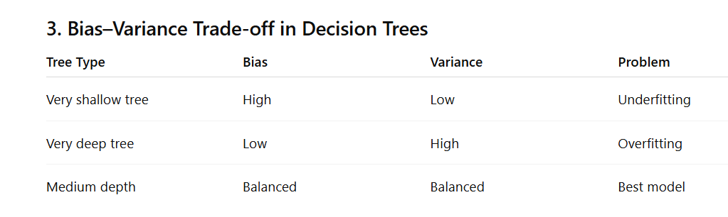

Slide 11
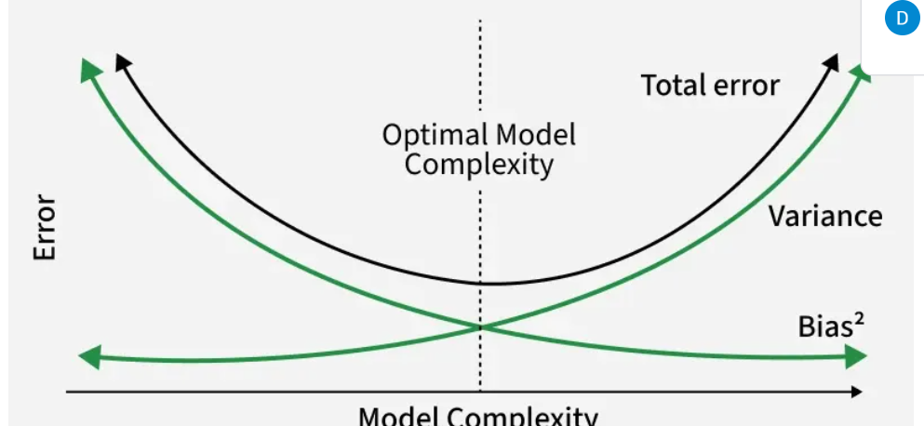

Slide 12
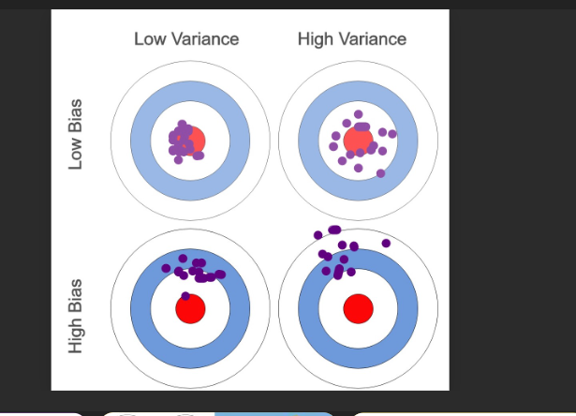

Slide 13
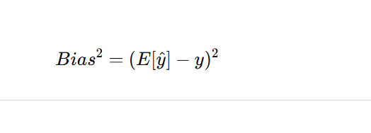
1. Bias Formula
Bias measures the difference between the average prediction and the true value.

Slide 14
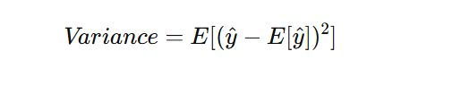
2. Variance Formula
Variance measures how much predictions vary around the average prediction.

Slide 15
Given
True value (y) = 10
Predictions: ŷ1 = 8, ŷ2 = 9, ŷ3 = 13
Mean Prediction E[ŷ] = (8 + 9 + 13) / 3 = 10

Slide 16
Bias Calculation
Bias = E[ŷ] − y
Bias = 10 − 10 = 0
Bias² = 0² = 0

Slide 17
Variance Calculation
Variance = [(8−10)² + (9−10)² + (13−10)²] / 3
Variance = (4 + 1 + 9) / 3
Variance = 14 / 3 = 4.67

Slide 18
Interpretation
Bias = 0 → Model is correct on average
Variance = 4.67 → Predictions vary significantly
Conclusion: Low Bias, High Variance (Overfitting)

